Slide 1
RDF Model 1.1
Mauricio Espinoza Mejía
mauricio.espinoza@ucuenca.edu.ec

Slide 2
Content
RDF W3C Overview
The basis of RDF
Internationalized Resource Identifier
Literals
Blank Nodes
More features of RDF
RDF Serialisations
Turtle
RDF Vocabularies
RDF on the Web
RDF subleties

Slide 3
RDF: W3C Overview
It extends the linking structure of the Web to use URIs IRIs to name the relationship between things as well as the two ends of the link (called “triple")
IRI: Internationalized Resource Identifier (in RDF 1.0, it was URI references)
This linking structure forms a directed, labeled graph.
Adapted from http://w3c.org/RDF.

Slide 4
RDF: W3C Overview
RDF stands for Resource Description Framework
RDF is more than XML: XML has a tree-based model, RDF has a graph-based model
Standardized and commonly used
W3C draft 1999
W3C recommendation RDF 1.0, 10.2.2004
W3C recommendation RDF 1.1, 25.2.2014
The RDF 1.1 abstract syntax is specified at:
http://www.w3.org/TR/rdf11-concepts/
RDF 1.1 Primer is a gentle introduction to RDF 1.1:
http://www.w3.org/TR/rdf11-primer/
Adapted from http://w3c.org/RDF.

Slide 5
Content
RDF W3C Overview
The basis of RDF
Internationalized Resource Identifier
Literals
Blank Nodes
More features of RDF
RDF Serialisations
Turtle
RDF Vocabularies
RDF on the Web
RDF subleties

Slide 6
The basis of RDF: resources
Resources: objects identified with IRIs (URIs)
– document (text, picture) on the Web (URL)
http://www.cs.vu.nl/index.html
– specific part of a document (URL fragment identifier)
http://example.org/cities.html#Amsterdam
– book in the library, 'real-world' object
isbn://5031-4444-3333
– person at university, 'real-world' object
http://eyaloren.org/foaf.rdf#me
– concept
http://cyc.org/Concept/Mammal
http://cyc.org/Concept/Dog

Slide 7
RDF Triples
All information in RDF is expressed using a triple pattern.
A triple consists of a subject, a predicate, and an object.
Examples:
subject predicate object
Azuay has capital Cuenca
Cuenca has mayor Pedro Palacios
Pedro Palacios born year 1976
Another word for an RDF triple is a statement or fact.
The elements of an RDF triple are either
URI IRIS references,
blank nodes, or
literals.

Slide 8
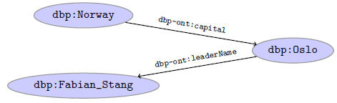
RDF Graphs
An RDF graph is a set of triples. E.g.,
dbp:Norway dbp-ont:capital dbp:Oslo .
dbp:Oslo dbp-ont:leaderName dbp:Fabian_Stang .
is an RDF graph containing two triples.
RDF graphs are often represented as a directed labeled graph:

Slide 9
Content
RDF W3C Overview
The basis of RDF
Internationalized Resource Identifier
Literals
Blank Nodes
More features of RDF
RDF Serialisations
Turtle
RDF Vocabularies
RDF on the Web
RDF subleties

Slide 10
Internationalized Resource Identifier
Used for giving an identity to a resource, so that the resource can be described and referred to
Global identifiers for resources
URI
URL
URN
IRI

Slide 11
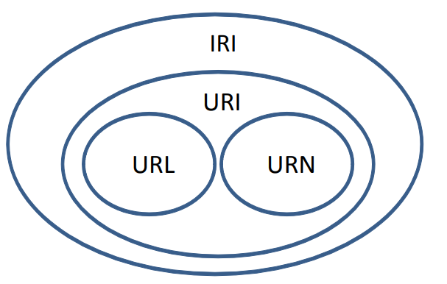

Slide 12
IRI schemes
In RDF, IRIs typically look like ‘normal’ URLs, often with fragment identifiers to point at specific parts of a document (such as a section in HTML) #
http://dublincore.org/usage/documents/principles/#element
Type IRI in a browser and you get useful info back!

Slide 13
IRIS(URIs) and QNames
IRIs are often long and hard to read and write.
Most serialisations use an abbreviation mechanism.
Define “prefixes", “namespaces".
RDF/XML format: XML namespaces and entities.
E.g., in Turtle serialisation:
@prefix dbp: <http://dbpedia.org/resource/> .
@prefix dbp-ont: <http://dbpedia.org/ontology/> .
A QName like dbp:Cuenca stands for http://dbpedia.org/resource/Cuenca

Slide 14
Question
Using IRIs to identify things. . .
1 . . . ensures that there are not two different names (IRIs) for the same thing
2 . . . ensures that one name (IRI) is not used for two different things
3 . . . makes it easier to avoid using one name (IRI) for two different things
Correct answer: 3
1 and 2 are impossible to achieve!

Slide 15
Content
RDF W3C Overview
The basis of RDF
Internationalized Resource Identifier
Literals
Blank Nodes
More features of RDF
RDF Serialisations
Turtle
RDF Vocabularies
RDF on the Web
RDF subleties

Slide 16

Literals
Literals are used to represent data values.
Literals can be
Plain, without language tag:
dbp:Oslo dbp-ont:officialName "Oslo" .
Plain, with language tag:
dbp:Norway rdfs:label "Norge"@no .
dbp:Norway rdfs:label "Norwegen"@de .
Typed with a URI indicating the type:
dbp:Oslo dbp-ont:population "629313"^^xsd:integer .
But not both, i.e., typed and with a language tag.
Usually represented with rectangles:

Slide 17
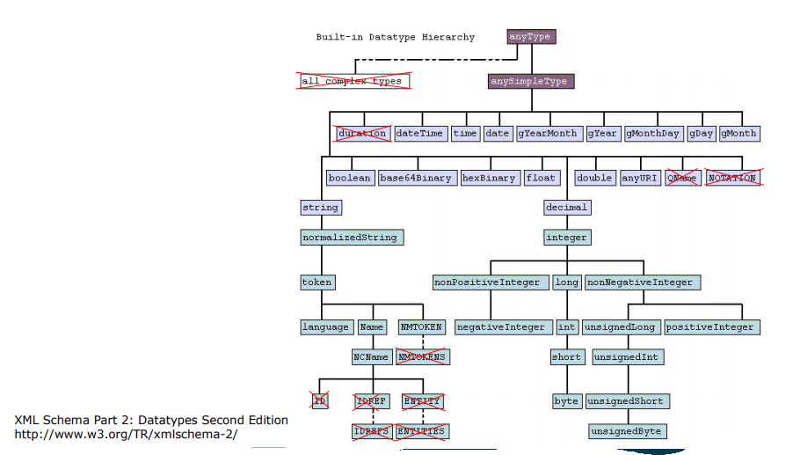
Datatypes for Literals
(Almost) all XML Schema datatypes may be used
Exception:
– XML specific types
– The underspecified type "duration"
– sequence types

Slide 18
Language Tags for Literals
Literals may be defined in different natural languages
– "München"@de
– "Munich"@en
• Note: the Semantic Web is multilingual!
• Language codes according to ISO 963
– ISO 963-1 (1963): two-digit codes, 136 languages
– ISO 963-2 (1998): three-digit codes, 464 languages
http://www.loc.gov/standards/iso639-2/php/English_list.php

Slide 19
Content
RDF W3C Overview
The basis of RDF
Internationalized Resource Identifier
Literals
Blank Nodes
More features of RDF
RDF Serialisations
Turtle
RDF Vocabularies
RDF on the Web
RDF subleties

Slide 20

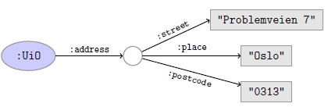
Blank nodes
Blank nodes are like resources without a URI.
Use when resource is unknown, or has no (natural) identifier.
Norway's capital has population 629313:
The address of UiO is Problemveien 7, 0313, Oslo:

Slide 21
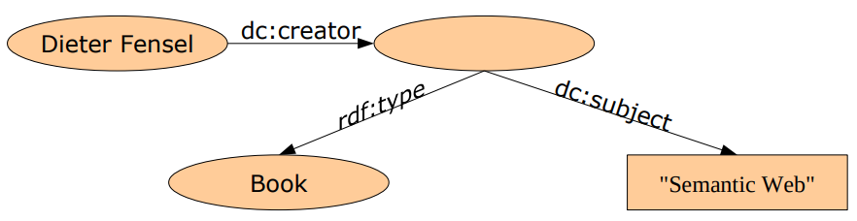
Blank Nodes: samples
Information that is not or cannot be specified
– "Dieter Fensel has written a book about the Semantic Web"

Slide 22
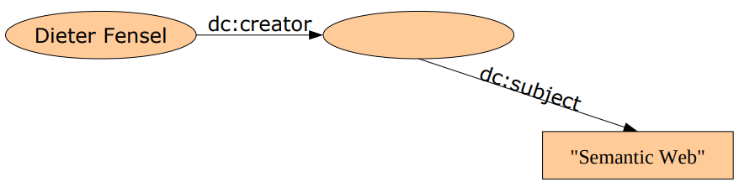
Blank Nodes: samples
Information that is not or cannot be specified
– "Dieter Fensel has written something about the Semantic Web."

Slide 23
Application of Blank Nodes: n-ary Predicates
RDF predicates always connect a subject and an object
– i.e., in the sense of predicate logic, they are binary predicates
:Mauricio :works_for :UCuenca .
⇔ works_for(Mauricio, UCuenca) .
• Sometimes, n-ary predicates are needed
– has_ingredient(Recipe, Sugar, 100g)

Slide 24
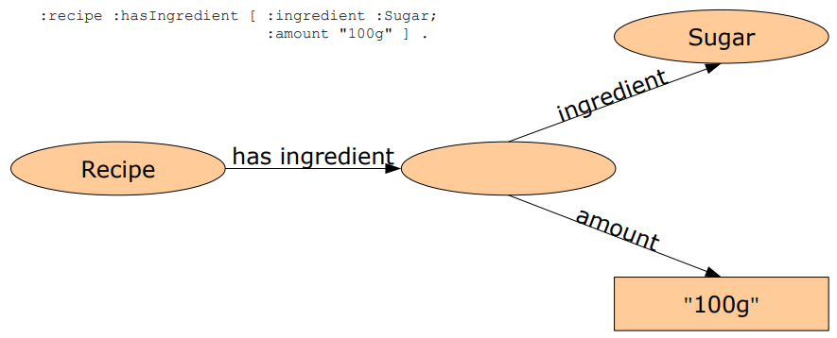
Application of Blank Nodes: n-ary Predicates

Slide 25
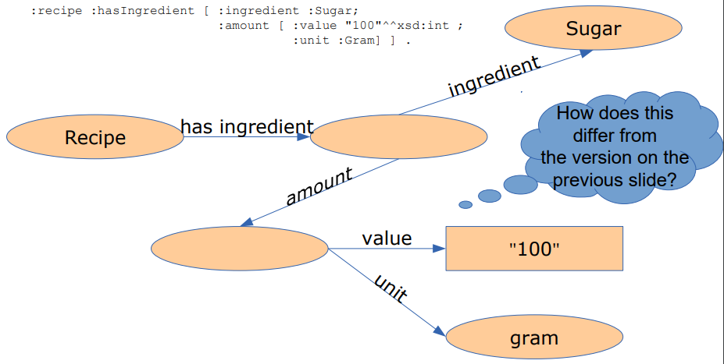
Application of Blank Nodes: n-ary Predicates

Slide 26

RDF Triple Grammar
Literals and blank nodes may not appear everywhere in triples

Slide 27
Práctica 7

